Slide 1
Reactors: A Case for Predictable, Virtualized
Actor Database Systems
Vivek Shah , Marcos Antonio Vaz Salles
University of Copenhagen (DMS@DIKU)

Slide 2
Increasing NEW oltp application diversity
Notes:
The growth of web and mobile computing devices has altered the landscape of classical OLTP processing applications. This class of new OLTP applications now include various new evolving domains such as MMORPG, online trading applications, evolving retail platforms, digital exchange applications, online bidding applications, payment gateways, social networking applications, e-commerce applications, collaborative editing platforms.

Slide 3
NEW OLTP APPLICATION TRENDS
Increasing complexity of application logic
Latency is critical
Scalability matters
Notes:
This new class of OLTP applications exhibit properties which bear resemblance to classic OLTP applications in their need for performance demands. However, they are exhibiting increasingly complexity of application logic that interacts with data owing to application diversity. The examples of growing application logic ...

Slide 4
optimizing for latency in new oltp applications
Client
Application Server
Database server
Notes:
Discuss how stored procedures in the database are key for performance of new OLTP applications

Slide 5
NEW OLTP DATABASE TO THE RESCUE
Modern hardware is fast evolving
New OLTP databases are being re-designed to harness their performance
Is the programming interface of stored procedures good enough ?
Notes:
Elaborate

Slide 6
When are stored procedures not good enough?
Data partitioning not enough
Require modularity and isolation
Performance Challenges
Software Engineering Challenges
Leverage locality & intra-procedure parallelism
Need abstractions to reason about performance
Need low-level control over deployment

Slide 7
Actor programming models are desirable
Modularity
Asynchronicity
Concurrency

Slide 8
Actor relational databases
Actor
Runtimes
Relational
Databases
??

Slide 9
How can we integrate actor programming models in modern relational databases with high performance?

Slide 10
Talk outline
Motivation / Problem Statement
2. Relational Actor Programming Model (Reactor)
3. Relational Actor Database System (ReactDB)
4. Evaluation

Slide 11
Relational actor programming model (REACTOR)
2.

Slide 12
Simplified bitcoin exchange application
settlement_risk
P_EXPOSURE | G_RISK
50000000 | 23400000
providers
NAME | RISK | TIME | WINDOW
CBIT_DK | 2341569 | 18-11-17 11:45:67 | 10
XBIT_US | 5909863 | 18-11-17 11:43:34 | 30
Providers
orders
Wallets
PROVIDER | WALLET | VALUE | SETTLED
CBIT_DK | 43 | 450 | N
XBIT_US | 42 | 1000 | Y
XBIT_US | 85 | 356.23 | N

Slide 13
What is a Reactor?
A reactor is an application-defined actor encapsulating state as relations
Concurrent (Single-threaded)
Isolated
Reactor Type
Schema + Methods
Reactor Instance
Type + Unique name assigned by the programmer

Slide 14
Examples of reactor types and instances
reactor Exchange { Relation settlement_risk { p_exposure float, g_risk float }; Relation provider_names { value varchar(32) }; }
reactor Provider { Relation orders { wallet int, value float, settled char(1) } Relation provider_info { risk float, time timestamp, window interval };
}
void auth_pay(pprovider, pwallet, pvalue) { ... }
float sim_risk(exposure) { … }
float calc_risk(p_exposure){ … } void add_entry(wallet, value){ … }
Name: OneEx
Name: XBIT_US
Name: CBIT_DK

Slide 15
Declarative queries within a reactor
Declarative queries to access isolated relational state within a reactor
Relational
Key/Value
Require modularity and isolation
Hybrid
Notes:
Add tuple vs relational databases

Slide 16
Declarative queries within a reactor
reactor Provider { Relation orders { wallet int, value float, settled char(1) }; Relation provider_info { risk float, time timestamp, window interval };
float calc_risk(p_exposure){
} void add_entry(wallet, value){ } }
SELECT SUM(value) INTO exposure FROM orders WHERE settled = 'N'; if exposure > p_exposure then abort; SELECT risk, time, window INTO p_risk, p_time, p_window FROM provider_info; if p_time < now() - p_window then p_risk := sim_risk(exposure); UPDATE provider_info SET risk = p_risk, time = now(); end if; return p_risk;
Exposure of a provider within threshold, risk simulated
INSERT INTO orders VALUES (wallet, value, ‘N’);
Notes:
Add tuple vs relational databases

Slide 17
Communication with reactors
Communication across reactors using asynchronous function calls by specifying reactor names
Leverage locality & intra-procedure parallelism
Need abstractions to reason about performance
Async method invocation
Future
result
Invocation:-
fut_res := fn(params) on reactor_name;
Synchronization:-
fut_res.get();
Require modularity and isolation

Slide 18
Communication with reactors
reactor Exchange { Relation settlement_risk { p_exposure float, g_risk float }; Relation provider_names { value varchar(32) }; void auth_pay(pprovider, pwallet, pvalue) { } }
SELECT g_risk, p_exposure INTO risk,exposure FROM settlement_risk; results := []; foreach p_provider in (SELECT value FROM provider_names) { res := calc_risk(exposure) on reactor p_provider; results.add(res); }
total_risk := 0; foreach res in results total_risk := total_risk + res.get();
Total simulated risk across providers within threshold
if total_risk + pvalue < risk then add_entry(pwallet, pvalue) on reactor pprovider; else abort; end if;

Slide 19
Automatic synchronization with reactors
Method invocation on the same reactor are synchronous despite the asynchronous communication model.
Parent method completes only when its children methods finish
Client
A
B
C
D
E
F
G
Notes:
Change crosses to some other bullet mark

Slide 20
Reactors provide transactional guarantees
All-or-nothing atomicity
Durability
Serializability guarantees
Unsafe program executions are aborted
Formalized equivalence to classical transactional model
A
B
A
B
A
B
C
D
Notes:
Change crosses to some other bullet mark

Slide 21
In-memory actor relational database system (ReactDB)
3.

Slide 22
In-memory database architecture design problem
…..
Reactors
Multi-core machine with large main memory
How do we map a set of reactors to the compute and memory resources of a large multi-core machine?

Slide 23
Delegate to operating system abstractions
Each reactor is a process vs each reactor is a thread
Overheads
Lack of scheduling flexibility and control

Slide 24
ReactDB architecture building blocks
Transaction Executors
Abstracts a physical core
Containers
Abstracts a set of physical cores and the memory shared by them

Slide 25
How do we map a set of reactors to the compute and memory resources of a large multi-core machine?
Map transaction executors to containers (many to one)
Map reactors to transaction executors
(many to many) such that a reactor belongs to one container only
Need low-level control over deployment
Specified manually at deployment time

Slide 26
Multi-core machine
Container
Container
TransactionExecutor
TransactionExecutor
Container
ReactDB
Architecture
Request
Queue
Request
Queue
Transaction Coordinator
Container
Transport Driver
Transaction Router

Slide 27
ReactDB deployments
Container
Container
Transaction
Executor
(A,B)
Transaction
Executor
(C,D)
Simple Router
Simple Router
shared-nothing

Slide 28
ReactDB deployments
Container
Container
Transaction
Executor
(A,B,C,D)
Transaction
Executor
(A,B,C,D)
Transaction
Executor
(A,B)
Transaction
Executor
(C,D)
Load Balancing Router
Affinity based Router
shared-everything
-without-affinity
shared-everything
-with-affinity
Hybrid deployments possible, not explored in this work

Slide 29
ReactDB implementation overview
Thread Management in Transaction Executors
Threadpool uses cooperative multitasking
Minimize context switches
Configurable multi-programming level
Maximize resource utilization

Slide 30
ReactDB implementation overview
Concurrency Control
Single Container
OCC protocol (Silo, [Tu et al. 2013])
Synchronous execution to leverage shared memory
Multi-Container
OCC + 2PC protocol
Asynchronous execution across containers
Storage Layer
Relations of all reactors in a container stored as primary indices (Masstree [Mao et al. 2012]) in memory
Durability not implemented yet

Slide 31
Evaluation of Reactors and ReactDB
4.

Slide 32
Can we really leverage asynchronicity for performance gains in new oltp using reactors and ReactDB ?

Slide 33
Experimental setup
Workload : Bitcoin exchange auth_pay program
Deployments
shared-everything-with-affinity container -> sequential
shared-nothing containers
Parallel exposure calculation followed by sequential risk calculation -> query-parallelism
Fully parallel exposure and risk calculation (as shown in example code before) -> procedure-parallelism

Slide 34
Experimental setup
Machine with 2X AMD Opteron 6274 with 8 cores@2.1 GHz, L1i 64 KB, L2 2MB, L3 shared 6 MB, 125 GB RAM, 64 bit Linux 4.1.15
1x Exchange reactor, 15X Provider reactors (30,000 orders per of which 800 latest orders used for exposure calculation)
Varying complexity of sim_risk by random number generation
Single worker to generate the workload

Slide 35
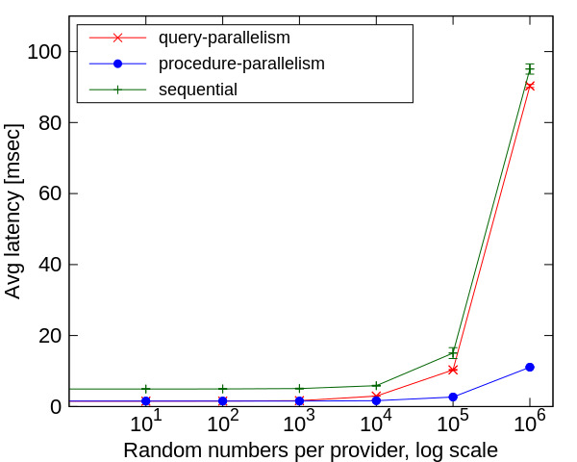
Asynchronicity gains manifest with increasing parallelizable application logic

Slide 36
What about the effect of load on gains from asynchronicity ?
Can db architecture virtualization help ?

Slide 37
Experimental setup
Machine Setup
Machine with 2X AMD Opteron 6274 with 8 cores@2.1 GHz, L1i 64 KB, L2 2 MB, L3 shared 6MB, 125 GB RAM, 64 bit Linux 4.1.15
Workload
100% TPC-C new-order augmented with artificial delay of 300 - 400 𝜇sec to simulate stock replenishment analytics per warehouse
Implemented by modeling a warehouse as a reactor
Deployment
shared-nothing vs shared-everything-with-affinity
Scale factor of 8, varying workers to simulate load on the database

Slide 38
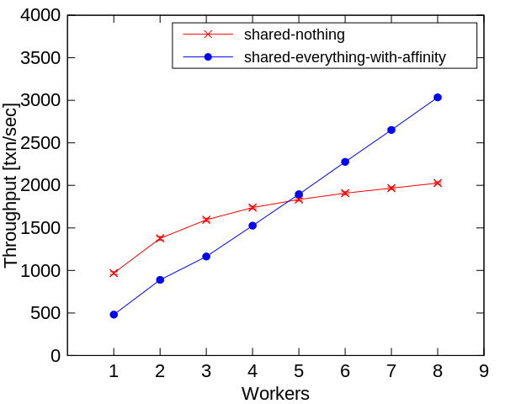
asynchronicity gains offset by queuing
shared-nothing deployment best at low load
cross over happens much earlier without delay @2 workers
Asynchronicity gains diminish with increasing load

Slide 39
More in the paper

Slide 40
Conclusion
NEW OLTP + modern databases -> Needs rethink of the existing stored procedure programming model
Reactor programming model marries actor programming construct with relational data model and querying
ReactDB leverages the Reactor programming model and a containerization mechanism to allow control of database architecture at deployment time
thanks!
Poster session tomorrow at 16:00

Slide 41
thanks!
Any questions?
You can find me at
http://www.diku.dk/~bonii
@bonivivek
bonii@di.ku.dk

